Slide 1
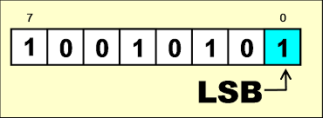
Dynamic Steganography Least Significant Bit with Stretch on Pixels Neighborhood

Slide 2
Abstract
This research aims to investigate the relationship between image size and the length of a secret message in steganography. The study combines the LSB method and the Stretch technique to hide secret messages in images. The Stretch technique dynamically enlarges the image size according to the length of the secret messages.

Slide 3
INTRODUCTION
various research studies related to steganography, which aims to hide secret messages using media such as digital images, audio, and video. The article highlights different methods used in steganography such as the Indicators-based LSB method, Modified LSB Insertion method, and LSB steganography combined with the Integer Wavelet Transform method. The article also focuses on the Stretch technique, which can enlarge the image without significant color changes, and the Least Significant Bit (LSB) algorithm, which minimizes image changes during message insertion. The article concludes by proposing a combination of the LSB steganography method with the Stretch technique to increase the capacity of secret message storage media in digital images and compares the original image size with the stretching stego image, MSE, and SSIM.

Slide 4
A. Steganography
Stegano is first discovered in the work of Johannes Trithemus with the title “Steganographia”. This word comes
from Greek (στεγανό-ς, γραφ-ειν) which has to mean "covered writing". Steganography is a field of computer
science that focuses on data security. In steganography, some media help steganography in hiding secret messages, such as in a digital image, audio, and video. The more undetectable a secret message contained in a
media the more secure the secret message.

Slide 5
B. Least Significant Bit
The Least Significant Bit (LSB) algorithm is one of the algorithms often used by researchers because of its simplicity and uniqueness [16]. The LSB algorithm used in digital images will insert every secret message bit in every last bit of the image pixel (the 8th bit of the image) [17]. The insertion of a secret message in the 8-pixel bit of this image will minimize color change or visual image damage so that it does not invite suspicion from any party

Slide 6
C. Stretch
C. Stretch Stretch is an activity to represent and change the original size of the image by increasing or decreasing the number of image pixels. In enlarging the size of an image, of course, we must maintain the image feasibility. Several image processing techniques are continuously being developed to maintain the enlarged image feasibility, including samplerate interpolation-based techniques . Changes in the original size of an image or changes in the resolution are often needed to show image details, creating documents needs in science such as astronomy, biology, and medicine

Slide 7
D. Nearest Neighbor Pixel
Neighbor pixels is a technique used to determine the value of neighboring pixels based on one reference pixel. For one pixel that is selected as a reference, we can find out 8 neighboring pixels based on the following mathematical formula [1]. If pixel P has coordinates x, y where x is a row, and y is a column, then the relationship of neighboring pixels to P (x, y )

Slide 8
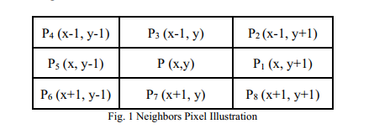
Example :

Slide 9
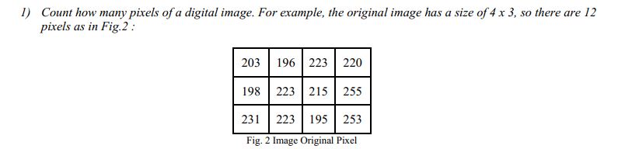


Slide 10





Slide 11
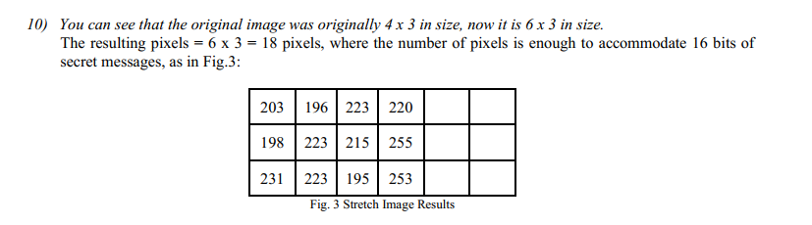
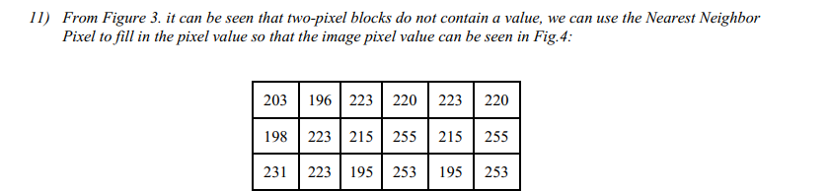

Slide 12
